Slide 1

Lecture 2
Data Types

Slide 2

Agenda
What is data types?
Setting up your JS development environment
Experimenting with data types

Slide 3
What are Data Types?

Slide 4
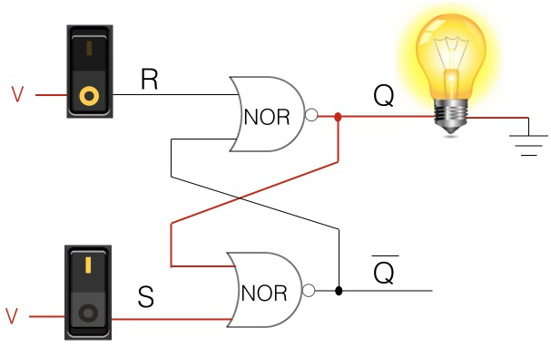
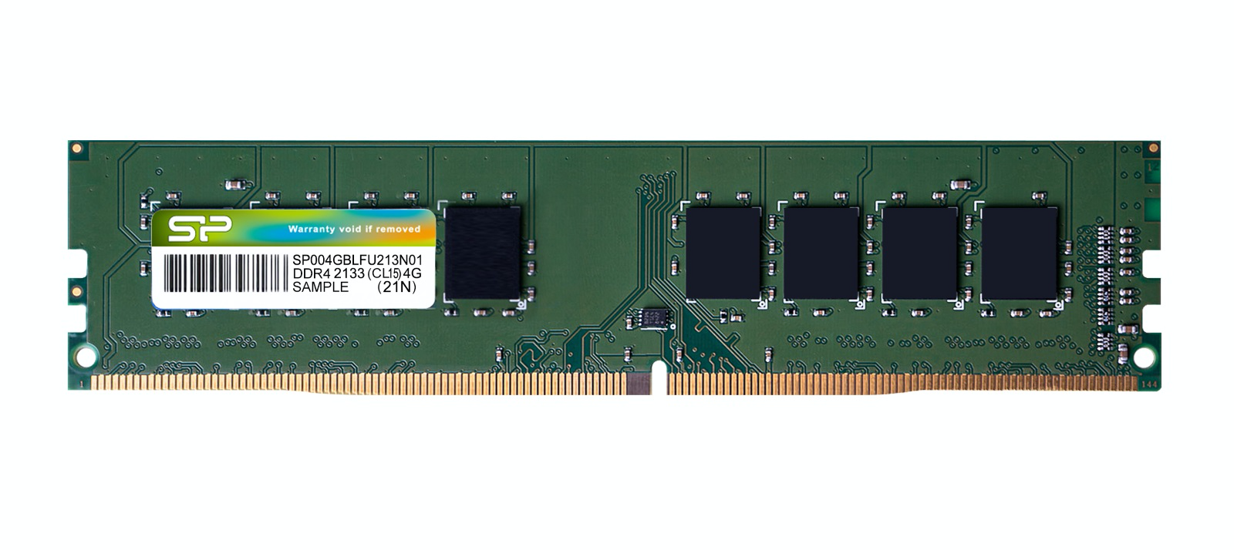

Data Storage
Computers are all about passing data around and storing data
Computer is essentially a data processing device

Slide 5

How do we represent them in code?
Using variables
variables are like water buckets
50
Apple
3.4
X
Y
Z

Slide 6
How do we represent them in code?
Using variables
variables are like water buckets
x = 50
y = “apple”
z = 3.4
50
Apple
3.4
X
Y
Z

Slide 7
Storage is expensive (in the old days)
So we need to customize the buckets
Small bucket for smaller data
Bucket Size
= 6 characters
50
Apple
3.4
X
Y
Z
2 characters
(Wasted 4 characters)
5 characters
(Wasted 1 characters)
3 characters
(Wasted 3 characters)

Slide 8
So we need data types to optimize storage
(one of the reasons only)
So we need to customize the buckets
Small bucket for smaller data
50
Apple
3.4
X
Z
Y

Slide 9
List of Data Types

Slide 10
How many types of buckets we have (in JS)?
Primitive
  String
  Number/BigInt
  Boolean
  Undefined
Structural Types
  Object
  Function (Forget about it for now)
Structural Root Primitive
  Null

Slide 11
Running JS Code Online

Slide 12
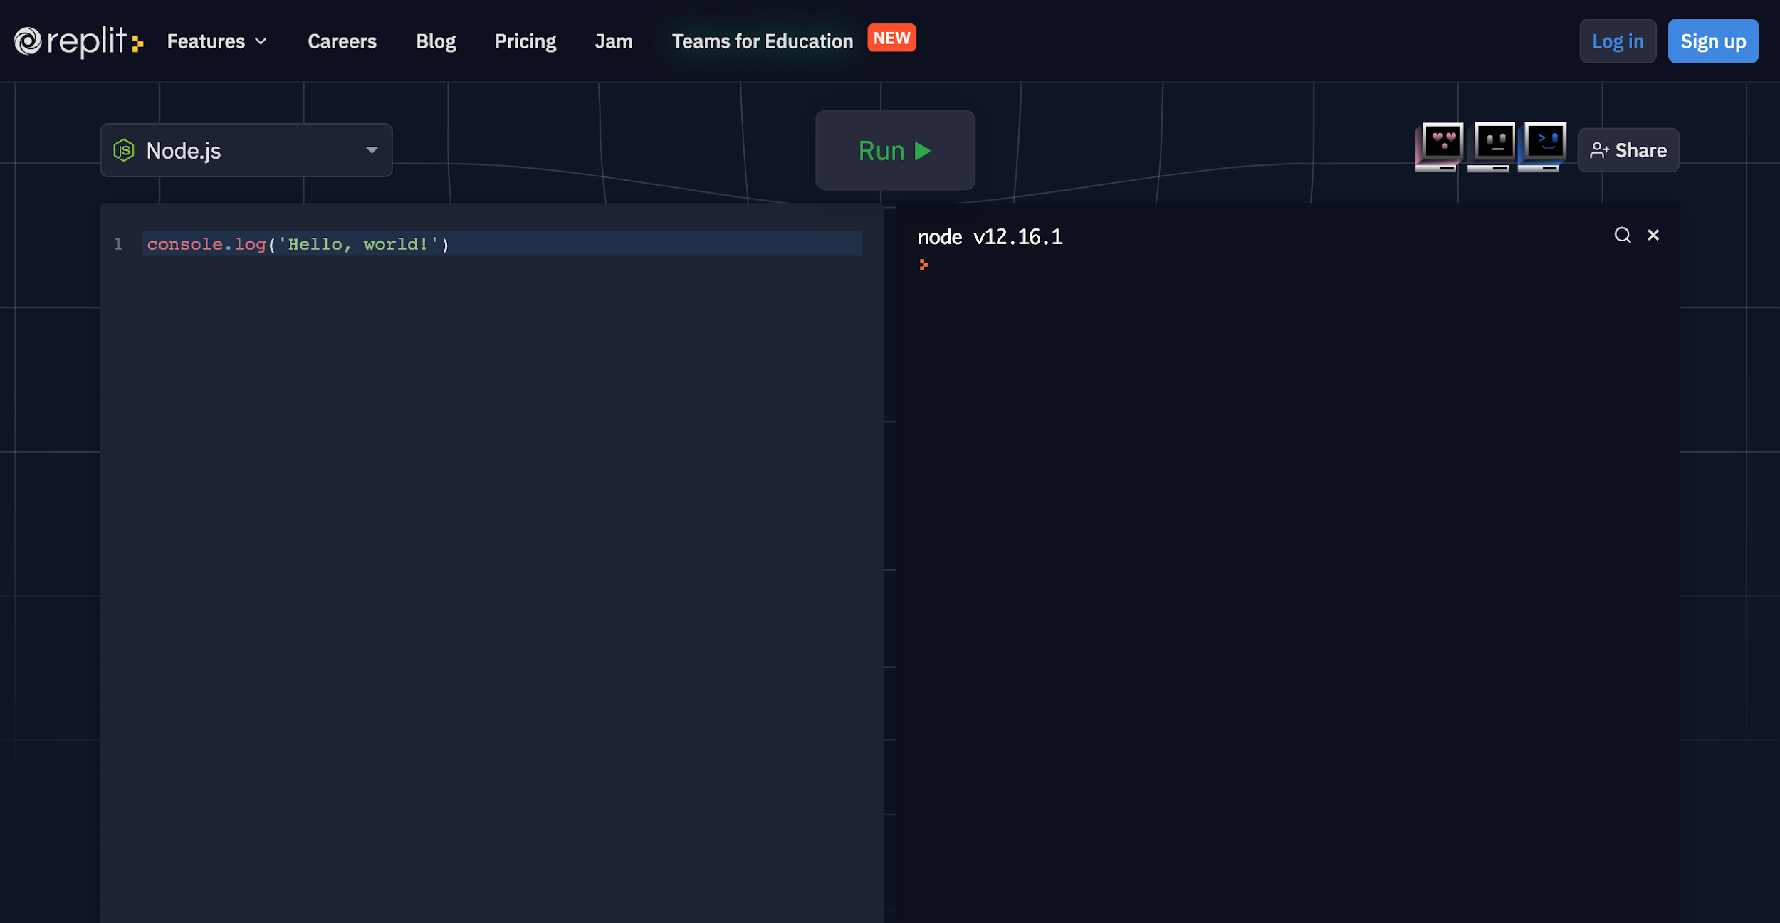
https://repl.it/languages/javascript

Slide 13
String

Slide 14
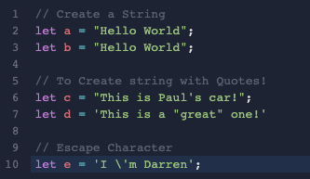
String = Text

Slide 15
Escape Characters
\n is replaced by the newline character
\t is replaced by the tab character
\\ is replaced by a single backslash (\)

Slide 16
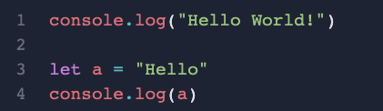

console.log
The code for us to print out something on the screen
Examples:

Slide 17
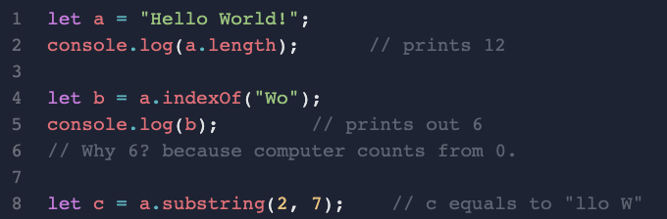
String Features

Slide 18
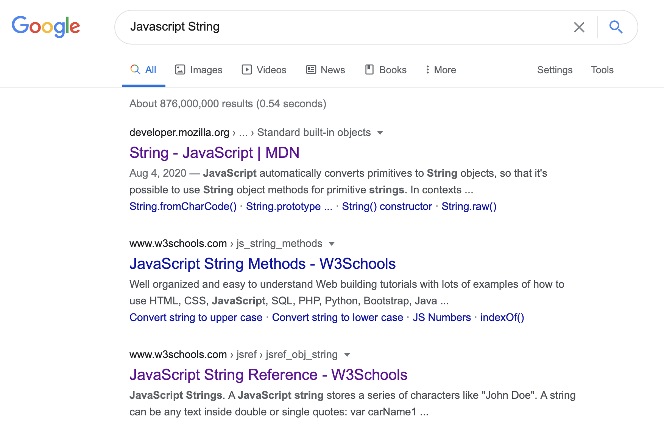
How many more?

Slide 19
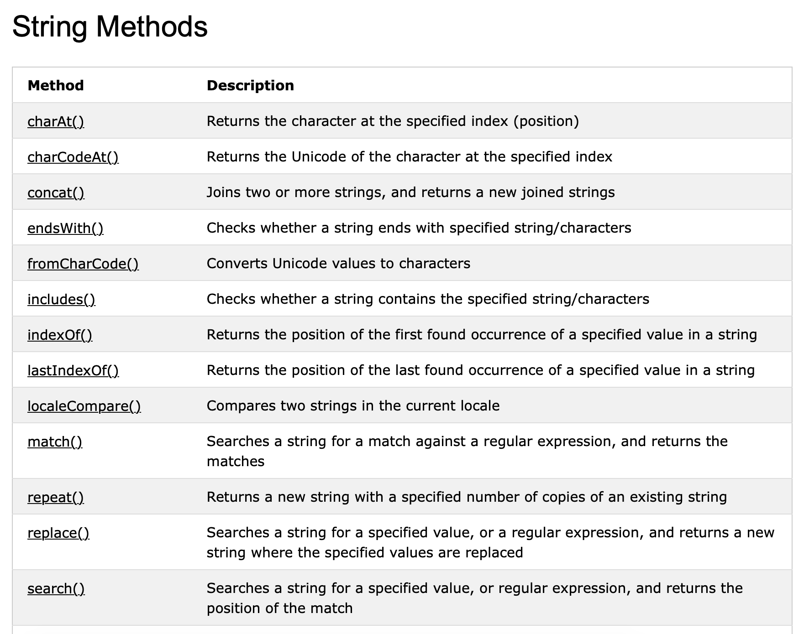
How many more?

Slide 20
One last function, and what is immutable?
let str1 = "Hello ";
let str2 = "world!";
let result = str1.concat(str2);
// Guess what is the value of str1 now?
// “Hello ” or “Hello world!”?

Slide 21
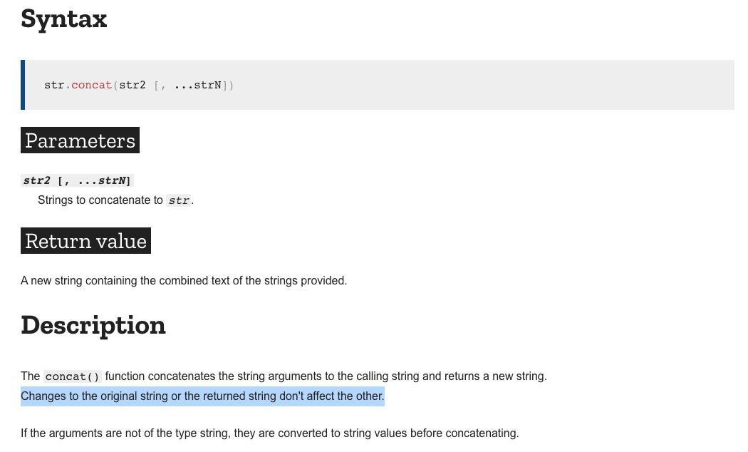
One last function, and what is immutable?

Slide 22
Numbers

Slide 23
Number
You are in luck, there are only 2 types of numbers in JavaScript - Number and BigInt.
// Very simple
let a = 3.5
let b = 3
let c = 1.3e10
// Range: from -(2⁵³ − 1) to 2⁵³ − 1
// Special Value: +Infinity, -Infinity, NaN (Not a Number)

Slide 24
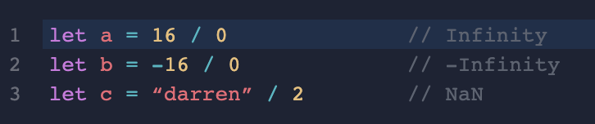
Special Numbers

Slide 25
BigInt (Optional)
Why? Save the space from decimals for storing large integers
Sample:
// the "n" at the end means it's a BigInt
let bigInt = 1234567890123456701234567890n;
NOTE: IE does not support BigInt -> avoid using it unless absolutely necessary

Slide 26
Boolean

Slide 27
Boolean
True or False
Sample:
let a = true;
let b = false;
it could also be a result of comparison
let c = 4 > 1; // c is true
let c = 10 < 9; // c is false

Slide 28
Undefined

Slide 29
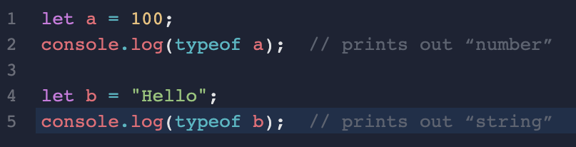
typeof
How do we check for the type of a variable or value?
There is a built-in feature of “typeof”
Sample:

Slide 30
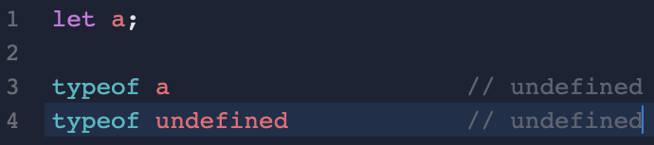
Undefined
Just FYI (maybe useful sometimes practically)
Sample:

Slide 31
Null

Slide 32
Null
Very useful, but be careful about it
Null means nothing (it’s different from undefined)
  Undefined - No value, so we don’t know the data type
  Null - The value is “no value”, so the data type is “null”
Null could also anything (e.g. because many developer misuse it)
  Representing Error
  Representing wrong input from user
  Representing “no information”
Sample:
let a = null;

Slide 33
Array

Slide 34
Array
Sometimes we want to store some “similar things” in a list, e.g. shopping list

Slide 35
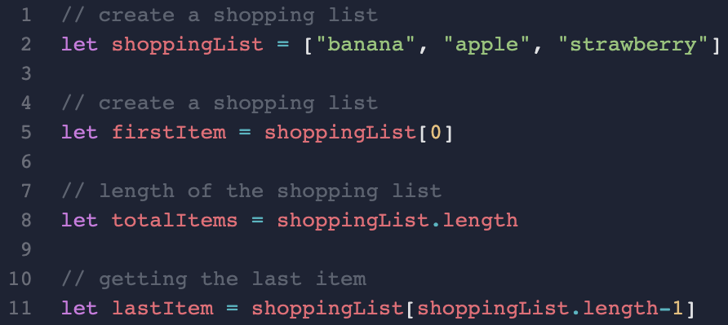
Retrieving data from array
When we want to retrieve items from the array, we will need to use their index (position)
Remember position start from 0

Slide 36
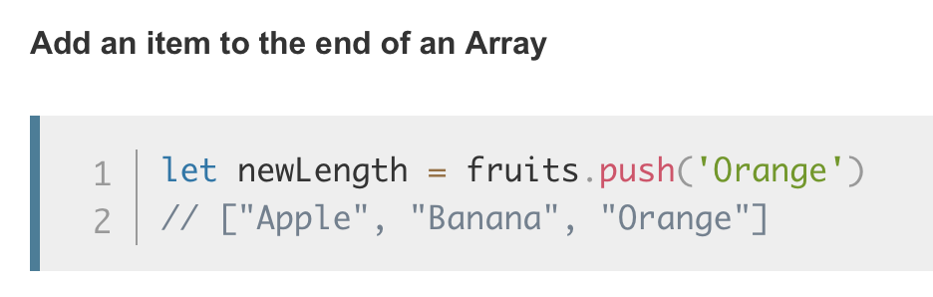
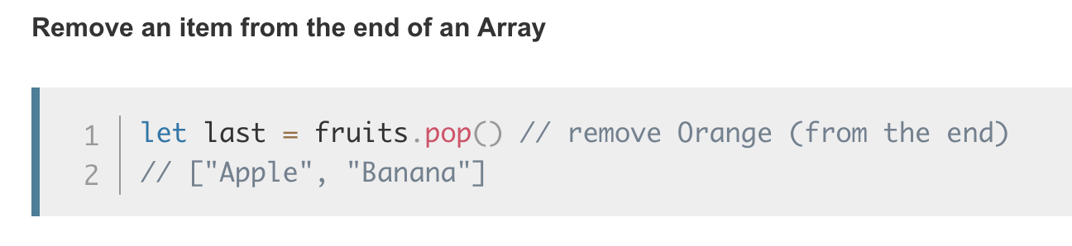
Array Operations

Slide 37
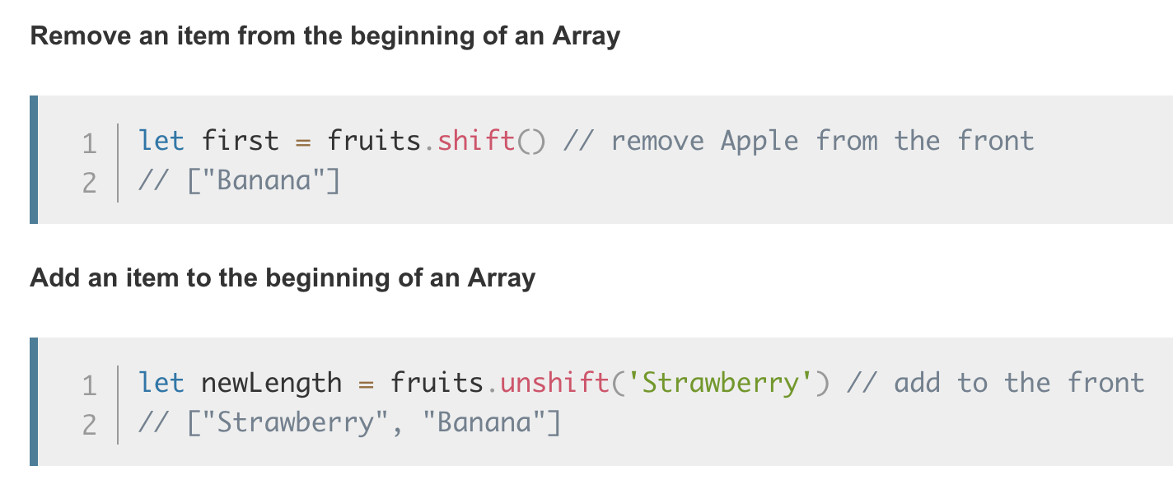
Array Operations

Slide 38
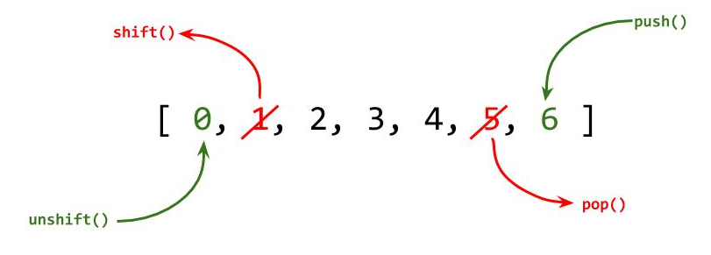
Array Operations

Slide 39
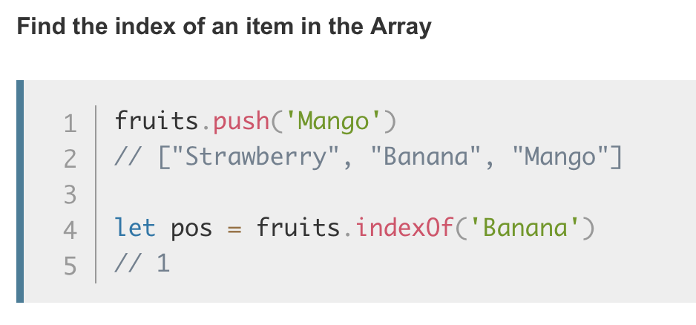
Array Operations

Slide 40
To learn them all
https://developer.mozilla.org/en-US/docs/Web/JavaScript/Reference/Global_Objects/Array

Slide 41
Objects

Slide 42
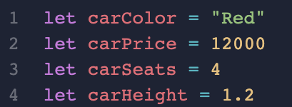
Object
What if I want to represent something that’s not a number or string? e.g. a car?

Slide 43
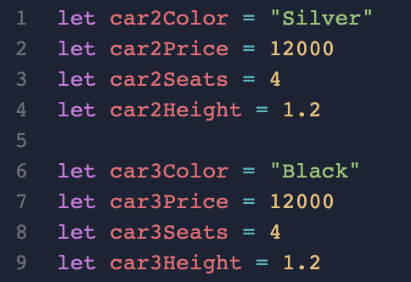
Object
And if I have a second and third car?

Slide 44
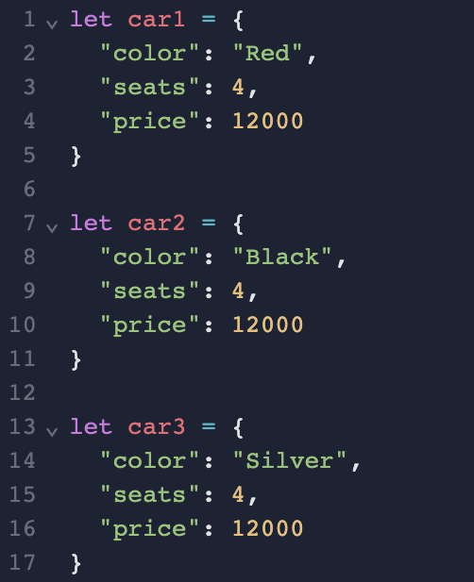
Object (Key/Value Pairs)
This is too troublesome, so we invented the concept of “object”
Consider object as designing your own data type/data model.
Key/Field/Property
Value

Slide 45
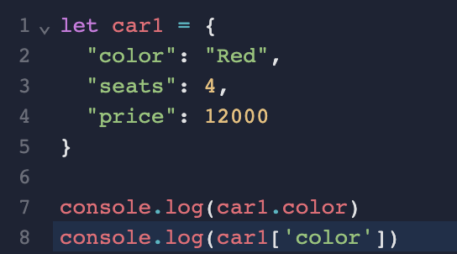
Using Objects
We will retrieve the data from objects using the key names
You can either use the dot notation or square bracket

Slide 46
Array of Objects

Slide 47
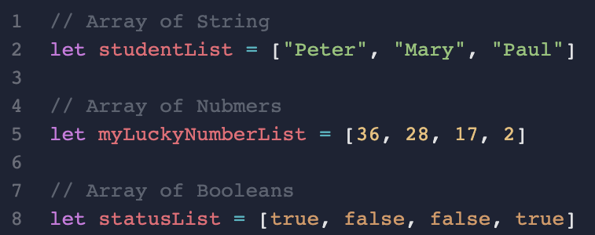
Array of different types
You could put anything into your array, including string, numbers, booleans.

Slide 48
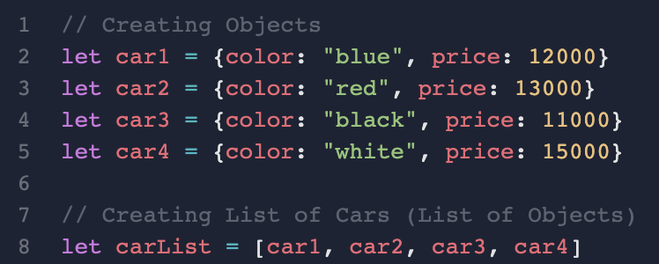
Array of Objects
You can also put objects in array, we call it "Array of Objects"
This can be used to represent a list of objects in the real world.

Slide 49
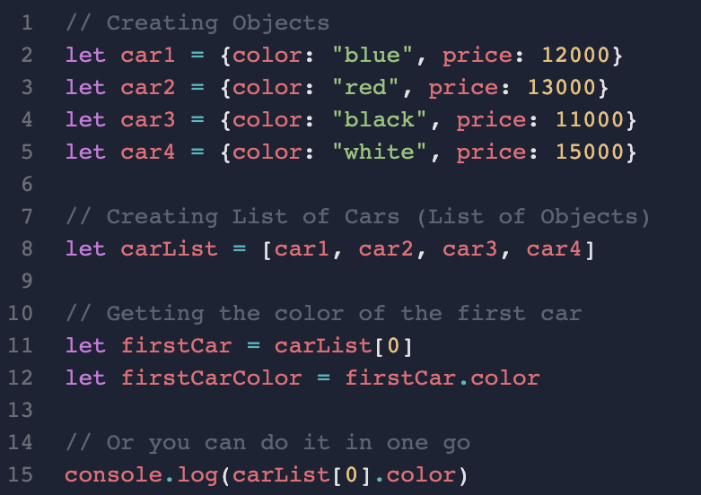
How to get data from an "Array of Objects"
You need to first extract the item, then get the value by the key name

Slide 50
Constants and Dynamic Typing

Slide 51



Constants
You can create a variable that its value cannot be changes anymore

Slide 52
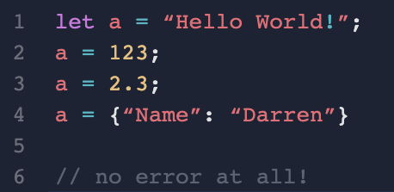
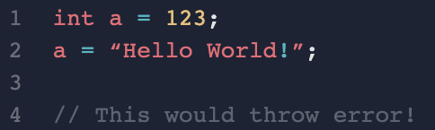
Dynamic Typing
JavaScript
Other Strong Typing Language (e.g Java)

